Slide 1
Designing & Implementing
Data Pipelines for
Scientific Research
Environments and reproducibility

Slide 2









Development environments
Development environments come in two flavors:
Full IDEs
Editors
Editors can only write code, so you usually have to run and debug in the command line.
A full IDE has support for compiling, debugging and installing packages.
VS Code is somewhere in between.
Notes:
This first section is going to be about general guidelines you should try and follow. In general if you have any questions, just interrupt, because I’d hate for you to forget something.
So the medium in which you choose to write and test your code, is up to you, but there are levels of difficulty and different learning experiences for each. So MATLAB is up there as an IDE as well, and also you have R Studio.
Vs code is somewhere in between. It offers in my opinion the best programming experience over the widest range of languages, and it’s free.
I’ve gone between all different kinds of editors and IDEs, I really like PyCharm and Spyder. PyCharm have a pay model, and the way they handle environments is a little annoying at first. They essentially create a new environment for each project, it’s a little similar to Visual Studio in that sense. For large bits of software in C++, I find full VS to be pretty good.
It can also be language dependent as well, like if your working in MATLAB, you pretty much have no choice but to use their IDE, which is disappointing. Another reason why I don’t like MATLAB, is that some stuff isn’t open source. I’ve had the experience before where I’ve been trying to trace the source of some differences in between python and matlab software, and I get to a locked binary file in matlab.
Why Python?
Well python is free, many of the libraries are free, and it has the most mature and the best documented machine learning and data libraries of any language. MATLAB is great for matrix operations, making it the go to for a lot of engineers, but you have to pay for it, and like I said it’s not open source. R is the best for statistical analysis, but it doesn’t really integrate well with other software, and doesn’t scale well.
For a good all round, easy to use, easily scalable, mature language, Python is superb.
There are other languages, like C++, Julia, and Rust, which have their place, but try doing visualization with C++… And actually, libraries like PyTorch, TensorFlow and Numpy are actually written in C but with python wrappers, so we can access them. So you get the speed of C, with the usability and safety of Python.

Slide 3
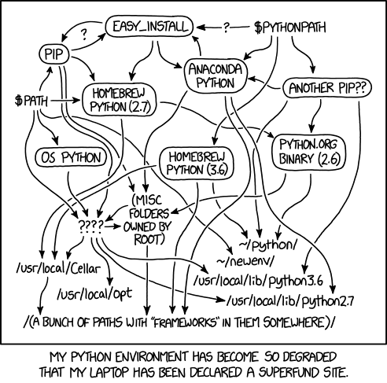
Virtual environments
If you don’t use virtual environments in python, you’re probably going to have a bad time.
Virtual environments are lightweight isolated versions of python.
For the labs we’re going to use venv, but a variety of package and environment managers exist, such as conda and poetry.
Virtual environments are nice and easy to use and manage. There is really no excuse for not using them on every project you do.
Notes:
Let’s say you have two projects that you’re working on. One of them uses the library called X. This library requires another library called A which has to be version 1.
In your other project, you need to use library Y. Now this library also requires A, but it needs version 2. So now, when you install library Y, it’s going to also install A v2 and overwrite v1. But now when you go back to using the project that uses library X which uses A v1, it’s going to break.
Environments eliminate this problem. Furthermore, you can just grab all of your installed libraries and dependences, and dump them into a requirements file, so that anybody who looks at you code, can actually just install the required packages, without having to mess around.
Conda is a very good initial package manager to use. But I actually do discourage the use of conda. The GUI is just painfully slow, and pip and conda do not play well together. I have just had moments where I have raged at my computer purely because of conda.
Also in terms of operating systems. Generally, your experience will be better with MacOS and Linux than with Windows. I used to be a diehard Windows person. I just couldn’t stand MacOS, but now I’ve done a complete 180. I simply love the Mac experience. Windows is still my number 1 for gaming though. But thanks to the Steam deck, it’s slowly starting to shift a little, which is only good for the consumers.

Slide 4
Reproducibility
The whole reason we care about all this, why we’re going to this much trouble, is to ensure reproducibility.
You want other researchers to be able to pick up your work and reproduce it.
One way of doing this is using virtual environments which we have discussed.
Another way is controlling sources of randomness!
So where does randomness come from in software?
Internal libraries (e.g. python’s random number generation)
External libraries (e.g. numpy random number generation, pytorch weight initialization)
Notes:
Why are we bothering to do all this? We want reproducibility. Multiple fields are battling through a replication crisis right now, and it’s not unique to social sciences. Physics and computer science also have these issues. Papers published at big conferences like ICML, Neurips, ICLR, sometimes have questionable peer review processes.
I like to draw a comparison between running a formula one team. You’re the boss of a formula one team. Every single thing your drivers do in the car is monitored. Heart rate, breathing rate, location on track, speed on the straight, speed though every part of every corner, steering angle, throttle input, brake input, lateral and longitudinal G-forces. Everything is collected and compared to the driver on the other side of the garage. So if you’re driver is slow, everyone knows about it, there is nowhere to hide. And we should take this driver, and use this information to make them better, faster. And if they can’t we can just get someone else who can do the job. The driver is your code. Your code needs to be open to scrutiny so that the peer review process can function effectively. Back in the 50s and 60s, you get in the car and you just try and be quicker than everyone else over a single lap.

Slide 5
Controlling randomness
It seems strange to try and control randomness… but we can!
Computer programs don’t use true random number generation. Instead they use pseudorandom number generation.
Fortunately for us, when given the same starting conditions, they will produce the same series of numbers.
We do have to be careful however. We only want to control the randomness in such a way as to make our work reproducible. So be aware of WHEN you set random seeds in your code.
We should try and separate the data processing from the model, but this is sometimes difficult to do. Here is example of how improperly separating feature engineering and models can lead to methodological flaws:
Notes:
Why are we bothering to do all this? We want reproducibility. Multiple fields are battling through a replication crisis right now, and it’s not unique to social sciences. Physics and computer science also have these issues. Papers published at big conferences like ICML, Neurips, ICLR, sometimes have questionable peer review processes.
I like to draw a comparison between running a formula one team. You’re the boss of a formula one team. Every single thing your drivers do in the car is monitored. Heart rate, breathing rate, location on track, speed on the straight, speed though every part of every corner, steering angle, throttle input, brake input, lateral and longitudinal G-forces. Everything is collected and compared to the driver on the other side of the garage. So if you’re driver is slow, everyone knows about it, there is nowhere to hide. And we should take this driver, and use this information to make them better, faster. And if they can’t we can just get someone else who can do the job. The driver is your code. Your code needs to be open to scrutiny so that the peer review process can function effectively. Back in the 50s and 60s, you get in the car and you just try and be quicker than everyone else over a single lap.

Slide 6
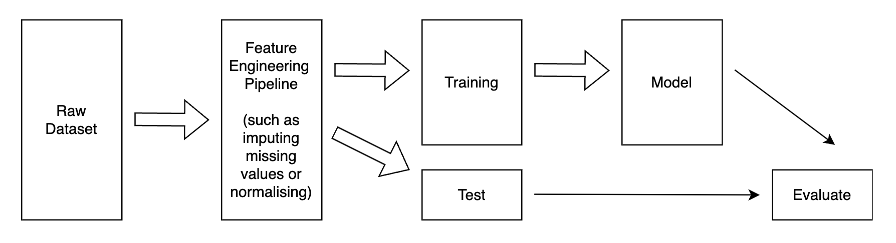
Reproducibility
What is the problem here?
Notes:
Why are we bothering to do all this? We want reproducibility. Multiple fields are battling through a replication crisis right now, and it’s not unique to social sciences. Physics and computer science also have these issues. Papers published at big conferences like ICML, Neurips, ICLR, sometimes have questionable peer review processes.
I like to draw a comparison between running a formula one team. You’re the boss of a formula one team. Every single thing your drivers do in the car is monitored. Heart rate, breathing rate, location on track, speed on the straight, speed though every part of every corner, steering angle, throttle input, brake input, lateral and longitudinal G-forces. Everything is collected and compared to the driver on the other side of the garage. So if you’re driver is slow, everyone knows about it, there is nowhere to hide. And we should take this driver, and use this information to make them better, faster. And if they can’t we can just get someone else who can do the job. The driver is your code. Your code needs to be open to scrutiny so that the peer review process can function effectively. Back in the 50s and 60s, you get in the car and you just try and be quicker than everyone else over a single lap.

Slide 7
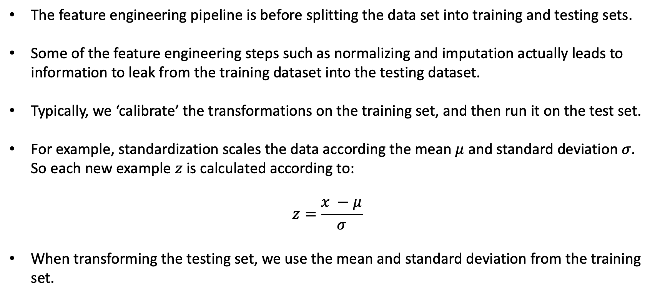
Reproducibility
The feature engineering pipeline is before splitting the data set into training and testing sets.
Some of the feature engineering steps such as normalizing and imputation actually leads to information to leak from the training dataset into the testing dataset.
Typically, we ‘calibrate’ the transformations on the training set, and then run it on the test set.
For example, standardization scales the data according the mean $μ$ and standard deviation $σ$. So each new example $z$ is calculated according to:
$$z=\frac{x −μ}{σ}$$
When transforming the testing set, we use the mean and standard deviation from the training set.
Notes:
Why are we bothering to do all this? We want reproducibility. Multiple fields are battling through a replication crisis right now, and it’s not unique to social sciences. Physics and computer science also have these issues. Papers published at big conferences like ICML, Neurips, ICLR, sometimes have questionable peer review processes.
I like to draw a comparison between running a formula one team. You’re the boss of a formula one team. Every single thing your drivers do in the car is monitored. Heart rate, breathing rate, location on track, speed on the straight, speed though every part of every corner, steering angle, throttle input, brake input, lateral and longitudinal G-forces. Everything is collected and compared to the driver on the other side of the garage. So if you’re driver is slow, everyone knows about it, there is nowhere to hide. And we should take this driver, and use this information to make them better, faster. And if they can’t we can just get someone else who can do the job. The driver is your code. Your code needs to be open to scrutiny so that the peer review process can function effectively. Back in the 50s and 60s, you get in the car and you just try and be quicker than everyone else over a single lap.

Slide 8
Caveats
Sometimes you simply cannot control all sources of randomness.
This can be experimental issues such as batch effects of noise in a physical device.
Similarly in PyTorch, you cannot expect perfect reproducibility across CPUs and GPUs.
You also cannot control some nondeterministic algorithms in PyTorch, which we will see later.
In general, you can expect to reproduce most random behavior from Numpy to MATLAB, but you should expect some ‘gotchas’.
For example Numpy and MATLAB will use different thresholding for certain linear algebra operations
DO NOT MAKE DESIGN DECISIONS BASED ON RANDOM SEEDS!!!
Notes:
Why are we bothering to do all this? We want reproducibility. Multiple fields are battling through a replication crisis right now, and it’s not unique to social sciences. Physics and computer science also have these issues. Papers published at big conferences like ICML, Neurips, ICLR, sometimes have questionable peer review processes.
I like to draw a comparison between running a formula one team. You’re the boss of a formula one team. Every single thing your drivers do in the car is monitored. Heart rate, breathing rate, location on track, speed on the straight, speed though every part of every corner, steering angle, throttle input, brake input, lateral and longitudinal G-forces. Everything is collected and compared to the driver on the other side of the garage. So if you’re driver is slow, everyone knows about it, there is nowhere to hide. And we should take this driver, and use this information to make them better, faster. And if they can’t we can just get someone else who can do the job. The driver is your code. Your code needs to be open to scrutiny so that the peer review process can function effectively. Back in the 50s and 60s, you get in the car and you just try and be quicker than everyone else over a single lap.

Slide 9
Design decisions to aid reproducibility – naming
Your code is readable, well documented, and well structured.
Make good variable name decisions:
I_o_th
output_current_threshold
Name functions and methods based on what they do:
is_intercepting():
find_intercepts()
You should try and aim for ‘self documenting’ code.
A good guide to formatting code can be found on the PEP8 website
Notes:
Make good variable names. And I know this may seem obvious, but I guarantee that one day, you will be about to make the decision to use a terrible variable or function name!

Slide 10
Design decisions to aid reproducibility – documenting
Document your code with actual docstrings, type hints, and comments.
Docstrings and type hints will help people understand what various parts of your pipeline do, what the arguments are supposed to be, and what your functions return.
Don’t comment everything. It should be blindingly obvious what most parts of your code do, but sometimes it’s nice to include a little comment to help the reader.
As a general rule, if writing a line of code caused your brain to hurt, just leave a small comment explaining what the line does.
Notes:
Document your code using docstrings. So another great thing about vs code, is that it has automatic docstring generation. So it’ll do a lot of this for you. You should also use type hints as well. So Python doesn’t enforce typing, it’s what we call a dynamically typed language, vs something like C++ which is statically typed, so you have to go through and specify for every new variable what type it is.

Slide 11
Design decisions to aid reproducibility – structure
Where possible, your software should be modular and general. For example, if you have a function that passes a moving window over an audio file, like a filter, it should work on any audio file, not just the one you are interested in.
You want your code to be like LEGO bricks.
You have used the LEGO bricks to create a specific object, and you have given people instructions on how to also build this object. But at the same time, a brick is just a brick, and you can use it to create anything you like.
Don’t try and force using OO design. If you don’t need to build a class for it, then don’t. Plenty of successful packages just use functions.
Modularity makes it easy for you to test your code, and easier for others to see what is going on.
Notes:
Document your code using docstrings. So another great thing about vs code, is that it has automatic docstring generation. So it’ll do a lot of this for you. You should also use type hints as well. So Python doesn’t enforce typing, it’s what we call a dynamically typed language, vs something like C++ which is statically typed, so you have to go through and specify for every new variable what type it is.

Slide 12
“A foolish consistency is the hobgoblin of little minds.”
- Ralph Waldo Emerson
Notes:
If you’re already working on a project that has style conventions that differ to established conventions, don’t worry about breaking them. And if you do something that’s a little bit different, so what? Just try and be consistent.
Just a quick note on copilot and gpt. GPT, you’ve probably heard of. And copilot is sort of like GPT for code. It’s integrated into vs code.

